Slide 1
Introduction to Concurrent Programming with GPUs
GUI/CLI Tools for Identifying Installed GPU Hardware
Notes:
Hello this lecture will show GUI and CLI tools that can be useful for you in determining you GPU hardware and specifications

Slide 2
GUI/CLI Tools for Identifying Installed GPU Hardware
Operating System Hardware Tools
General Command Line Tools
Advanced Vendor Tools
Notes:
There are 3 classes of tools that we will show in this video: OS-provided tools for hardware profiling, command line tools that are generally available, and vendor-specific tools for more detail information about the hardware that they have created.

Slide 3
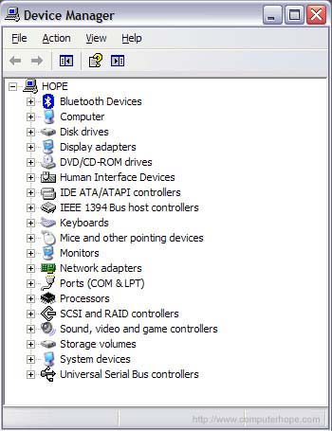
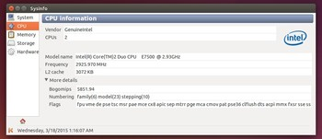
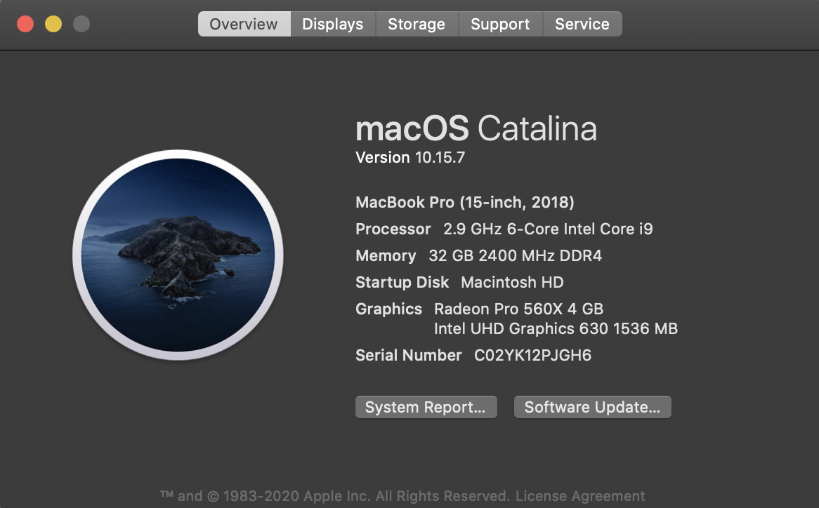
Operating System Hardware Tools
[1]
Windows DeviceManager
Mac OS About This Mac
Ubuntu/Mint Linux’s Sysinfo
[2]
Notes:
The first hardware profiling tool is the Windows DeviceManger.
It’s interface is a large tree-like structure that you will need to find Display adapters and under that you should see any installed GPU hardware.
Next is the Linux Sysinfo tool, installed by default in Ubuntu and Mint linux distros.
On the applications left side you will see categories for CPUs, system (operating system), GPUs, etc.
If you have a macOS compliant system, the About this Mac tool will show information GPUs under the Displays tab.

Slide 4
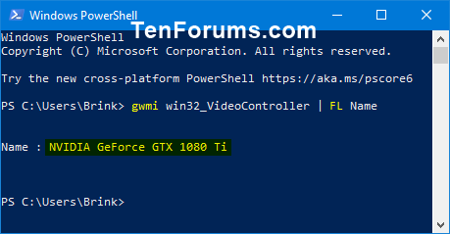
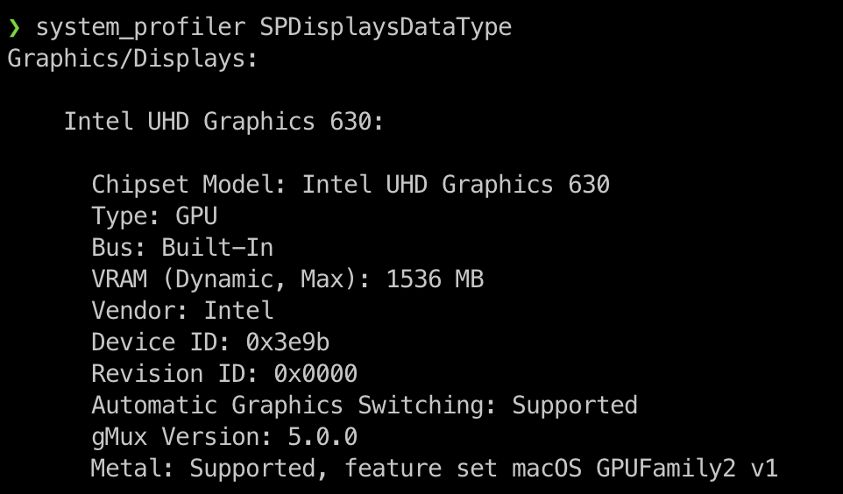
General Command Line Tools
[3]
Windows Command Prompt - wmic path win32_VideoController get name
Mac OS system_profiler - system_profiler SPDisplaysDataType
Unix, Linux, and Linux-like lspci - lspci | grep -i --color 'vga\|3d\|2d’
01:00.0 VGA compatible controller: NVIDIA Corporation GK104GLM [Quadro K5000M] (rev a1)
[4]
Notes:
The windows command prompt or powershell’s wmic or gwmi commands will show a plethora of hardware information with the win32_VideoController flag you will get GPU information.
On macOS there is the system_profiler cli tool which can pass the SPDisplaysDataType to narrow down into GPUs/Displays.
Most linux distributions provide the lspci tool for listing pci information.
Like most linux commands they can be strung together and use of the grep command will pull out lines matching a pattern.
The grep command to look for output lines is ‘vga \/3d\/2d’.
I have added the –color for use of color to make things a little clearer.
Pipe the output of lspci into the grep command and now you have only the output needed to show GPU hardware.

Slide 5
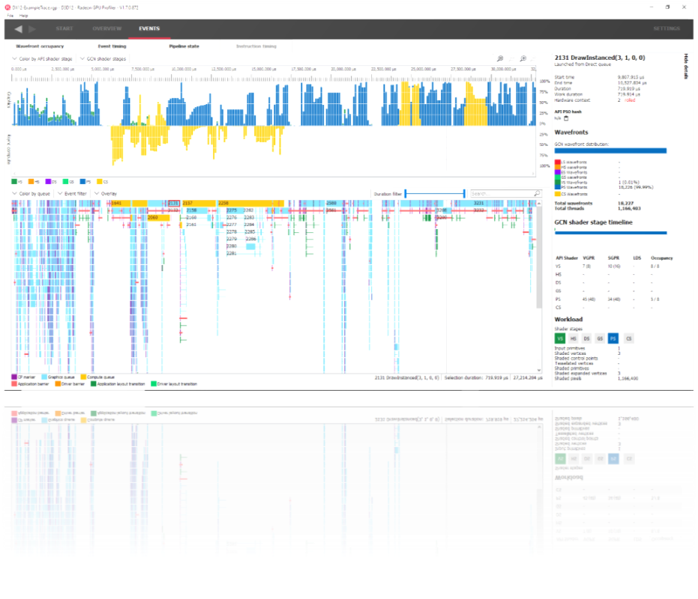
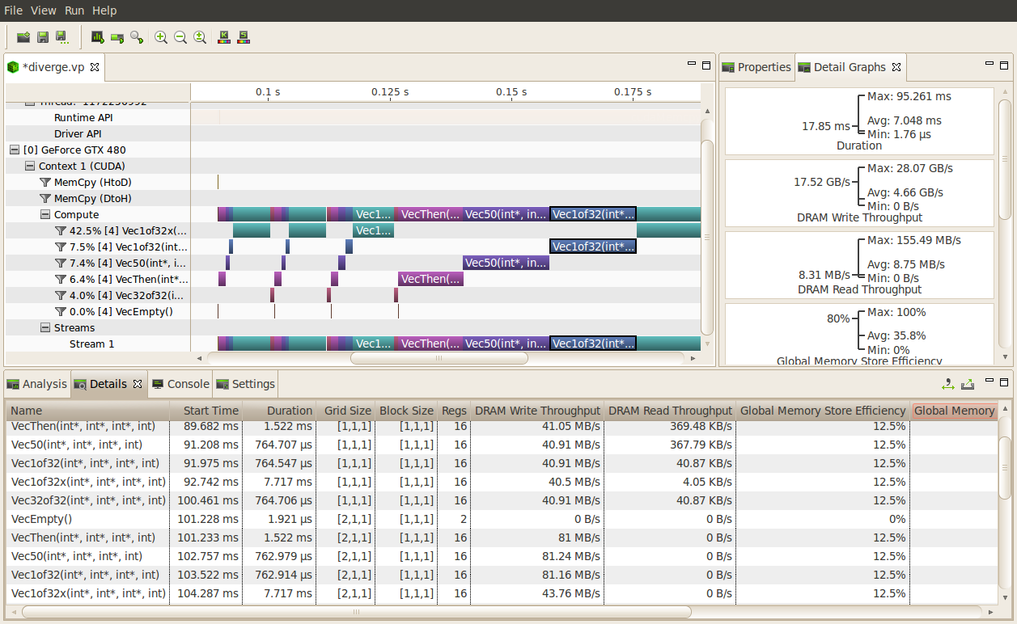
Advanced Vendor Tools
[5]
[6]
AMD Radeon GPU Profiler
Nvidia Profiler
Notes:
The two biggest players in dedicated GPUs, AMD and Nvidia, have their own profilers.
These tools are very helpful in determining which operations (memory copies) and hardware (streaming processors, etc.) are being actively used at any point.
These tools are great for taking code that is running and identifying what is happening at any point, which can be a perfect way to identify memory leaks or vastly underperforming code.

Slide 6
Bibliography
[1] computerhope.com 2021. computerhope.com How to find hardware and other specifications. Retrieved from https://www.computerhope.com/issues/ch000017.htm - windows7
[2] pugetsystems.com 2018. pugetsystems.com Linux hardware identification tools - now with more GUI. Retrieved from https://www.pugetsystems.com/labs/support-software/Linux-hardware-identification-tools---now-with-more-GUI-1104/
[3] tenforums.com 2020. tenforums.com How to Check What Graphics Card or GPU is in Windows PC. https://www.tenforums.com/tutorials/132824-check-what-graphics-card-gpu-windows-pc.html - option5
[4] level1techs.com 2018. level1techs.com Is my IOMMU set up correctly? I do lspci -nn and this is what I get. https://forum.level1techs.com/t/is-my-iommu-set-up-correctly-i-do-lspci-nn-and-this-is-what-i-get/130806

Slide 7
Bibliography continued
[5] gpuopen.com 2020. gpuopen.com AMD Radeon GPU Profiler. Retrieved from https://gpuopen.com/rgp/
[6] nvidia.com 2021. nvidia.com Nvidia Visual Profiler. Retrieved from https://developer.nvidia.com/nvidia-visual-profiler

